Slide 1
Microservices Architecture Software Engineering Presentation
Fateme Rahmani
Mahya Jamshidian
Mehrdad MirmohammadSadeghi
Negar Sakhaei

Slide 2
Outline
What is a Microservice Architecture?
Advantages
Tradeoffs
Technology Recommendations
Microservice Creation and Organization (Example)
Migration Strategies

Slide 3
What is a Distributed Software Architecture?
A distributed system is one in which the computing power and software is distributed across several servers, connected through a network, communicating and coordinating their actions by passing messages to each other.

Slide 4
What is a Microservice Architecture?
Microservice architecture is an approach to developing a single application as a suite of small services.
Each service:
Runs its own processes
Can be written in any programming language and is platform agnostic
Is independently deployable and replaceable
May use different storage technologies
Requires a minimum of centralized management

Slide 5
Large companies, such as Amazon, eBay, and Netflix, have already adopted microservice architecture as their main architecture.

Slide 6
Visual Interpretation of Architecture Patterns
Microservice Architecture Pattern
Traditional Monolithic Architecture Pattern
“Monoliths and microservices are not a simple binary choice.
Both are fuzzy definitions that mean many systems would lie in a
blurred boundary area among the two”
-Martin Fowler
Notes:
An approach to developing a single application as a suite of small services, each running in its own process and communicating with lightweight mechanisms. Each service is independent and can be written in different programming languages and use different data storage technologies. Services are built around business capabilities and are independently deployable using fully automated deployment and require a bare minimum of centralized management. https://martinfowler.com/articles/microservices.html
In a monolithic architecture, software components are tightly integrated as part of an application that is replicated across a server cluster to allow application scalability. In a microservices architecture, each software component is standalone and is loosely integrated with the other components. Each component is deployed independently across a server cluster and each component can be scaled independently across the cluster. This allows applications based on a microservice architecture to be reactive and adaptive to the user demand changes rapidly and without redesign.
Microservices architecture rely heavily on containerization, which allows microservices to be developed completely independently from each other using different languages and libraries. Only the external interfaces need to be standardized across all microservices.

Slide 7
Microservice Architecture Advantages
Greater efficiencies as they are typically paired with auto-scalers and load balancers.
Auto-scaling - A cloud computing service feature that automatically adds or removes computing resources based on actual demand
Load balancing -The process of distributing workload evenly across computing resources in a cloud computing environment
Notes:
Autoscaling definition source: http://searchcloudapplications.techtarget.com/definition/autoscaling
Load balancer definition source: http://searchcloudcomputing.techtarget.com/definition/cloud-load-balancing

Slide 8
Microservice Architecture Advantages
Greater efficiencies as they are typically paired with auto-scalers and load balancers.
Easily scalable in three ways:
by decomposition into simple functions (microservices)
by cloning microservices on demand
by partitioning data across a cluster
Services can be cloned or decommissioned based on user requests in real-time
Notes:
Autoscaling definition source: http://searchcloudapplications.techtarget.com/definition/autoscaling
Load balancer definition source: http://searchcloudcomputing.techtarget.com/definition/cloud-load-balancing

Slide 9
Tradeoffs in Adopting a Microservice Architecture
Shifting to microservices architecture means
Reducing code complexity while increasing operational complexity
Distributing data across multiple processes while ensuring data consistency across processes
Simplifying individual services while raising the complexity of coordinating many services

Slide 10
When Adopting a Microservice Architecture
Design for failure – applications must be designed and developed to tolerate the failures of other services or applications.
Single lifecycle ownership of the product – “You build it, you run it,” is the motto rather than the traditional practice of a software development team handing off a service to an IT operations team.
Exercise choice in platforms, language, & libraries that best suits the microservice functionality and team expertise rather than a single language or platform for the enterprise.
Notes:
Most microservices architecture pattern implementations rely on automated services to monitor, deploy, and manage their clusters. Scripting approaches have been developed to programmatically control the configuration and behavior of microservices clusters and allow them to be rapidly be modified or corrected.
The considerations noted on this slide all present challenges to agencies and IT staff, however the Guide provides information on the advantages of each of these approaches and why the benefits outweigh the challenges.

Slide 11
When Adopting a Microservice Architecture
Decentralized business and messaging rules – complex centralized message handling such as Enterprise Service Bus must give way to simple communications protocols. This is referred to as “smart endpoints, dumb pipes.”
Decentralized governance – minimize top down standards or technology sets and allow in-house open source model for sharing useful, tested code
Decentralized data management to service-level data management, often called polyglot persistence.
Microservices Distributed Database
Monolithic
Database
Notes:
Most microservices architecture pattern implementations rely on automated services to monitor, deploy, and manage their clusters. Scripting approaches have been developed to programmatically control the configuration and behavior of microservices clusters and allow them to be rapidly be modified or corrected.
The considerations noted on this slide all present challenges to agencies and IT staff, however the Guide provides information on the advantages of each of these approaches and why the benefits outweigh the challenges.

Slide 12
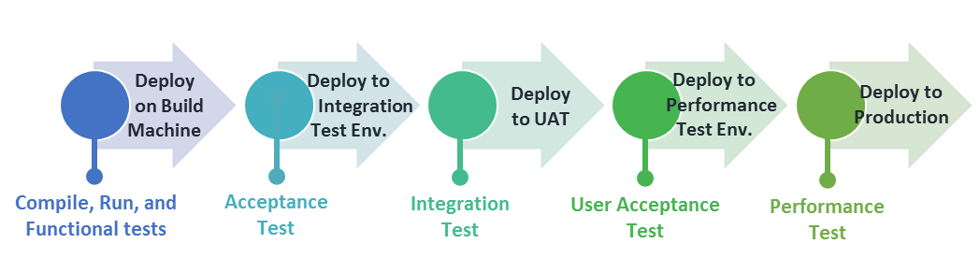
When Adopting a Microservice Architecture
Organize teams around business capabilities not technology layer
cross functional teams by business capability are requisite
traditional technology layer based teams (e.g., a database applications team or a user interface team) means extensive cross-team collaboration and costly delays
Move beyond Continuous Integration to Continuous Delivery
Maintain tight integration requirements within the microservice while easing external integration requirements
Continuous Delivery means development teams build software so that the software can be released to production at any time and by anyone on the team
Example of a Basic Automated Build Pipeline that Supports Continuous Integration

Slide 13
When Adopting a Microservice Architecture
The decomposition of applications into services needs to be based on the notion that services can be independently replaced and upgraded without affecting the other application services with which they interact
Software changes should be monitored to identify and refine how an application should be decomposed into services
Parts of the system that rarely change should be in a different service, or module, than those that often change
If two services need to be changed together repeatedly, they should be merged into a single module.

Slide 14
Outline
What is a Microservice Architecture?
Advantages
Tradeoffs
Technology Recommendations
Microservice Creation and Organization (Example)
Migration Strategies

Slide 15
Technology Recommendations for Services
The table lists recommended approaches for components based on a microservice architecture.
Component | Recommended Approach
API Gateway | Adoption of a cloud API framework.
Searching | Adopt a cloud enterprise search platform.
GIS Data Processing and Rendering | Adopt an Open Source scale out GIS server framework in combination with the use of cloud storage.
Data Stream Processing | Adopt a cloud stream processing framework
Messaging | Adopt a cloud messaging framework.
Content Delivery | Adopt either a cloud content delivery network solution or a commercial distributed content delivery solution.
*Based on a survey of industry practitioners

Slide 16
Technology Recommendations for User Interfaces
The table lists recommended approaches for user interfaces based on a microservice architecture.
Component | Recommended Approach
Web Applications | Adopt a cloud based web framework with an advanced client-side web development framework to support web design capabilities. Similarly, adopt a cloud monitoring service for web monitoring.
Mobile Applications | For design and monitoring capabilities, adopt a cloud mobile application deployment service.
Desktop Applications | No desktop application should be developed as part of a sustainable DOT EIP. Rather, use a Content Management Service based web application to provide desktop application like capabilities.
*Based on a survey of industry practitioners

Slide 17
Technology Recommendations for Storage
The table lists recommended approaches for storage based on a microservice architecture.
Component | Recommended Approach
Content Archiving | Adopt a mixed storage capability using cloud and on premise storage.
Content Caching | Either adopt a cloud or commercial caching and load balancing solution.
Content Tagging | Use either a commercial metadata repository, a custom user generated metadata repository, or a semantic web solution.
*Based on a survey of industry practitioners

Slide 18
Technology Recommendations for Database
The table lists recommended database approaches based on a microservice architecture.
Component | Recommended Approach
GIS Database Services | Adopt a cloud or on premise NoSQL geo capable database.
Document Database Services | Adopt an Open Source distributed document analysis engine.
Image, Video, and Binary Files Database Services | Adopt a basic cloud storage solution.
Financial Data Database Services | Adopt a commercial cloud enterprise solution.
Sensor Data Database Services | Adopt a cloud streaming framework based solution.
GIS Database Services | Adopt a cloud or on premise NoSQL geo capable database.
*Based on a survey of industry practitioners

Slide 19
Technology Recommendations for Management Tools
The table lists recommended management tool approaches based on a microservice architecture.
Component | Recommended Approach
Resources and Application Monitoring | Adopt a cloud monitoring solution.
Resources Provisioning and Scaling | Adopt either a cloud based serverless architecture or a cloud or on premise container based solution.
Content Auditing | Adopt cloud based commercial or Open Source content auditing and inventory software.
*Based on a survey of industry practitioners

Slide 20
Technology Recommendations for Security and Identity
The table lists recommended security & identity approaches based on a microservice architecture.
Component | Recommended Approach
Identity and Access Management | Adopt a cloud AIM solution (e.g., software as a service).
Security Audit | There is no single approach. Approaches are tool or human based. Propose Open Source or commercial security evaluation and monitoring tools for network and software layer, internal security audits and assessments, and external party assessments and penetration testing should be used together to provide security audits to sustainable DOT EIP.
*Based on a survey of industry practitioners

Slide 21
Outline
What is a Microservice Architecture?
Advantages
Tradeoffs
Technology Recommendations
Microservice Creation and Organization (Example)
Migration Strategies

Slide 22
Asset Management Implementation Example

Slide 23
Unified Modeling Language (UML) Diagrams
Types of Diagrams*:
Class (Block Definition)
Component and Data Flow
Deployment
Object
Package
Profile
Composite Structure (Internal Block)
Use Case
Activity
State Machine
Sequence
Communication
Interaction Overview
Timing
(Parametric)
UML is a way to visualize user interactions, processes, and system structure for software engineering using a collection of diagrams

Slide 24
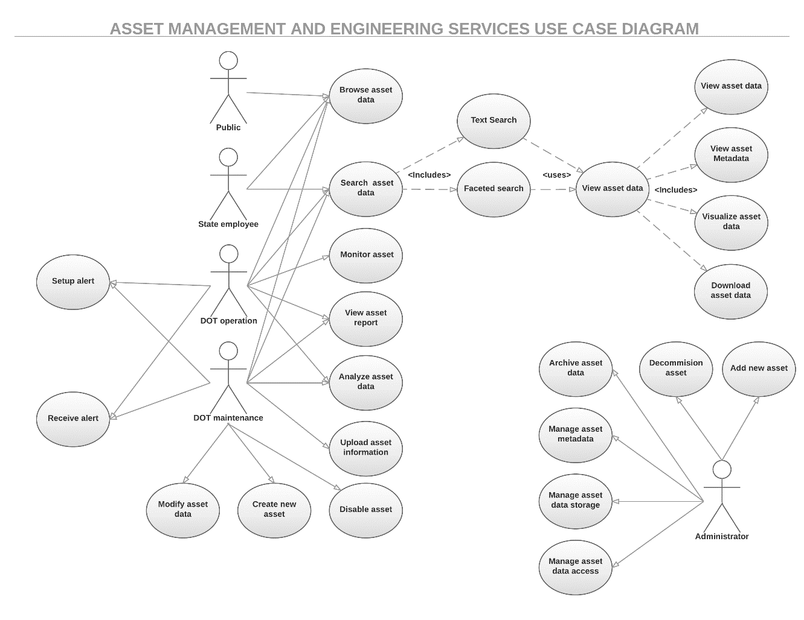
Use Case Diagram for Asset Management Service
The Use Case diagram for asset management depicts
5 actors – public entity, state employee, DOT operations personnel, DOT maintenance personnel, and service administrator
23 actions are enumerated ranging from “add new asset” to “set up alert.”

Slide 25
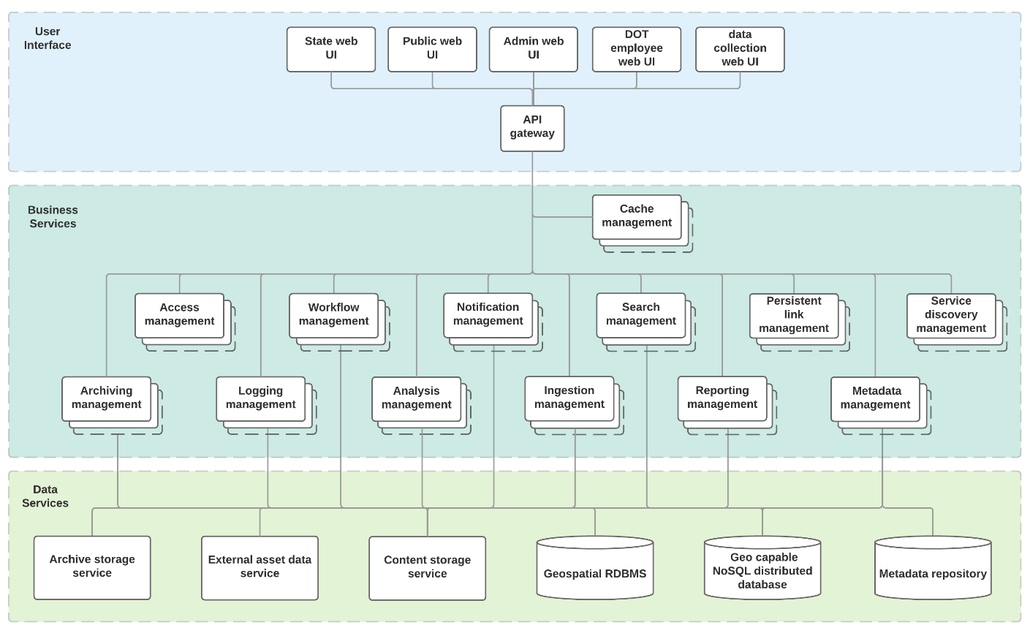
Block Definition Diagram (BDD) for Asset Mgmt. Service
The BDD communicates structural information about the system
Blocks can represent anything, components, services, etc.
The blocks for asset management include interface components, business services, and data services
Note the stacked blocks indicate the ability to scale and duplicate
Notes:
Block definition diagrams (BDDs) are created to communicate structural information about a system. This design technique creates extensibility in your system design by decoupling the clients of services from any specific implementation of a provider of those services. BDDs are not tied to any specific stage of the system life cycle or level of design. They are created and referenced to support stakeholder needs analysis, requirements definition, architectural design, performance analysis, test case development, and integration. BDDs provide a complementary view of an aspect of your system of interest.

Slide 26
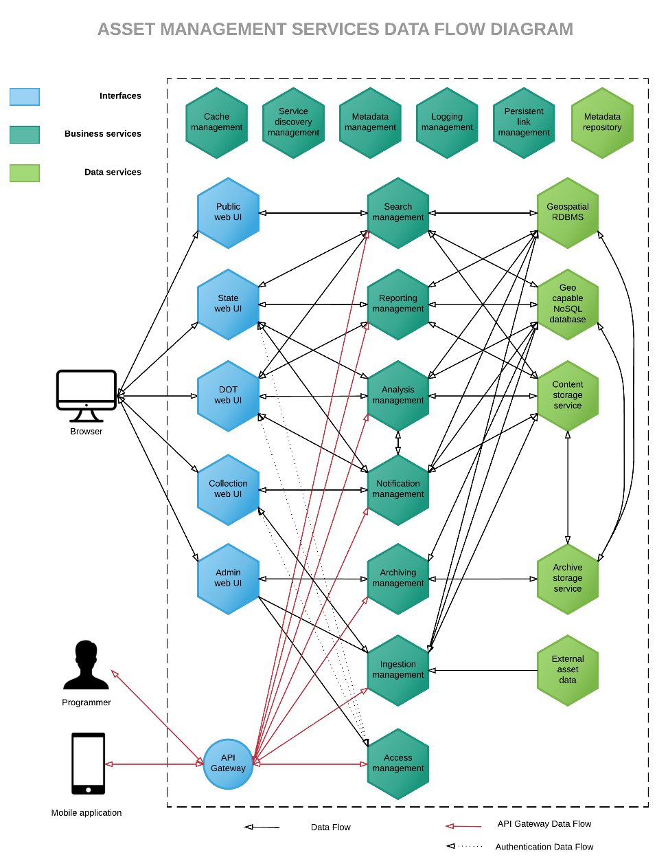
Component & Data Flow (CDF) Diagram for Asset Management
CDF diagrams define the data going through a system and any processing required
Microservices architecture greatly increases the amount of data flowing within an application and the complexity of the data exchanged between components, which makes data flow diagramming challenging
Showing every possible component or data exchange would render the diagram unreadable, therefore only the main data exchanges between the service components involved in the high-level use cases are presented.
Notes:
Data flow diagrams are designed to illustrate how data is processed by a system in terms of inputs and outputs. As its name indicates, its focus is on the flow of information – where data comes from, where it goes, and how it gets stored. Microservices architecture pattern greatly increases the amount data flowing within an application and the complexity of the data exchanged between components, which makes data flow diagramming challenging. Component and data flow diagrams may not show every single possible component or data exchange between each component for clarity purposes.

Slide 27
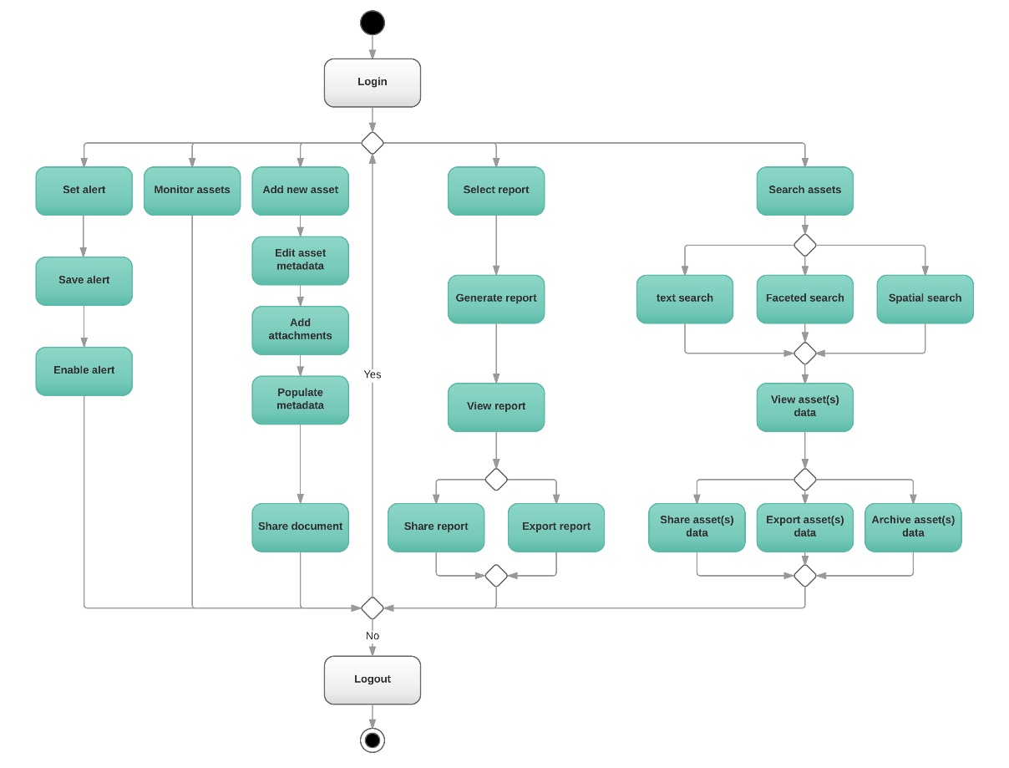
Asset Management Services Activity Diagram
Activity diagrams are designed to represent workflows of stepwise activities and actions that support choice, iteration, and concurrency.
They are intended to model both computational and organizational processes and show the overall flow of control.
This diagram representation focuses on the high-level workflow that would need to be followed to perform the tasks occurring in a session.
The activity diagram design is not intended to be exhaustive.

Slide 28
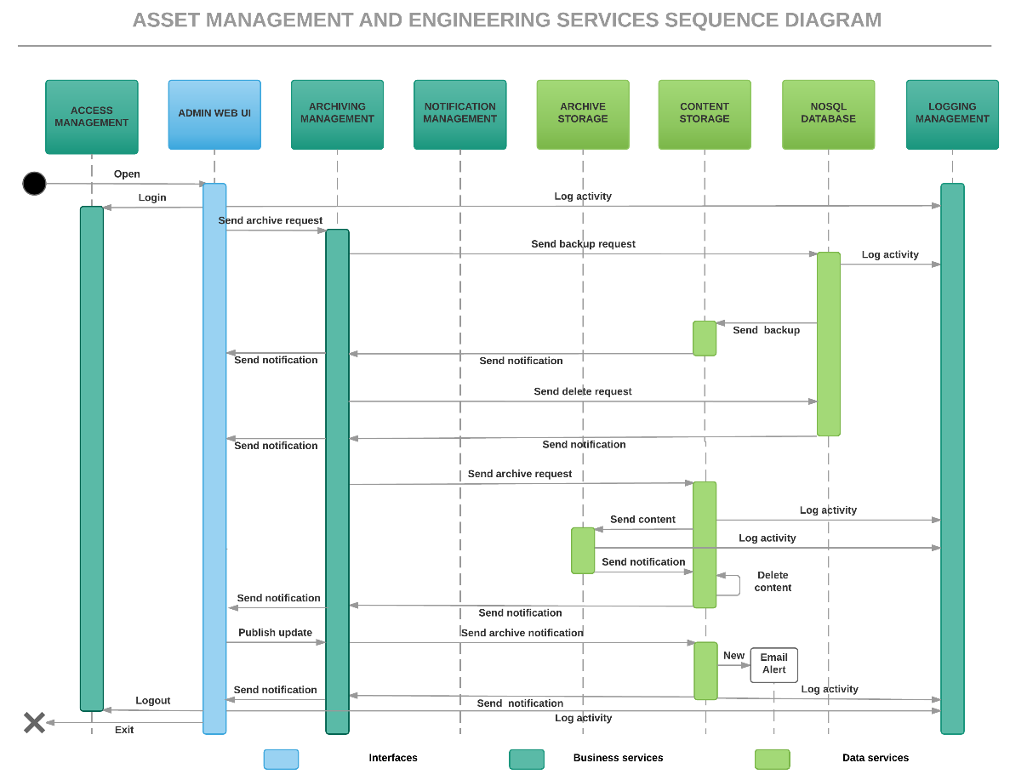
Asset Management Services Sequence Diagram
Sequence diagrams show how objects operate with one another and in what order during a specific scenario.
An important characteristic of a sequence diagram is that time passes from top to bottom
The illustrated scenario is specifically for “DOT maintenance employee archives older asset data”
Notes:
Sequence diagrams are interaction diagrams intended to show how objects operate with one another during a specific scenario and in what order. Sequence diagrams use a Message Sequence Chart construct to represent the system components and their interactions arranged in time sequence. They depict the objects involved in the scenario and the sequence of messages exchanged between the objects that are needed to carry out the functionality of the scenario.

Slide 29
Outline
What is a Microservice Architecture?
Advantages
Tradeoffs
Technology Recommendations
Microservice Creation and Organization (Example)
Migration Strategies

Slide 30
Migration Strategy: Use Incremental Refactoring
This migration is a perfect fit for incremental refactoring.
It should not be approached as a complete application rewrite, often called “big bang.”
Incremental refactoring enables the development team to build experience with microservices
Incremental refactoring allows teams to build experience with the service extraction process
“Refactoring is the process of changing a software system in such a way that it does not alter the external behavior of the code, yet improves its internal structure."
Martin Fowler
Notes:
Migration to microservices does not have to follow a complete application rewrite approach. Microservices based systems are modular and as such are a perfect fit for an incremental refactoring of the monolithic application. Monolithic application services can be gradually migrated out of the monolithic application and replaced by a new application consisting of microservices. The newly created service will replace the legacy of service and keep interacting with the remaining services operating on monolithic application. Over time, the amount of functionality implemented by the monolithic application shrinks until either it disappears entirely or it becomes just another microservice. This strategy is akin to servicing your car while driving down the highway at 70 mph which can be challenging, but it is far less risky than attempting a complete microservices rewrite.

Slide 31
When migrating from monolithic to microservices, using incremental refactoring is akin to safely servicing your car when driving 120km/h on the highway, and stopping the car is not an option.

Slide 32
Migration – Choose a Few Services
Monolithic applications often consist of hundreds of modules
Determine which modules to extract first. Choose modules that are:
Easy to extract
change frequently
have significantly different resource requirements compared to other modules
Do not share resource requirements
implement computationally expensive algorithms.
Notes:
Migration to microservices does not have to follow a complete application rewrite approach. Microservices based systems are modular and as such are a perfect fit for an incremental refactoring of the monolithic application. Monolithic application services can be gradually migrated out of the monolithic application and replaced by a new application consisting of microservices. The newly created service will replace the legacy of service and keep interacting with the remaining services operating on monolithic application. Over time, the amount of functionality implemented by the monolithic application shrinks until either it disappears entirely or it becomes just another microservice. This strategy is akin to servicing your car while driving down the highway at 70 mph which can be challenging, but it is far less risky than attempting a complete microservices rewrite.

Slide 33
Migration – How to Extract a Module
Step 1 – define a coarse-grained interface between the module and the monolith
Consider creating a bidirectional API
Pay close attention to the complexities of business logic refactoring. Significant code changes may be needed to break dependencies
Step 2 – Turn the module into a free-standing service
Write code for the monolith and service to communicate through an API mechanism
Combine module with a microservice framework that handles cross‑cutting concerns such as service discovery
Notes:
Migration to microservices does not have to follow a complete application rewrite approach. Microservices based systems are modular and as such are a perfect fit for an incremental refactoring of the monolithic application. Monolithic application services can be gradually migrated out of the monolithic application and replaced by a new application consisting of microservices. The newly created service will replace the legacy of service and keep interacting with the remaining services operating on monolithic application. Over time, the amount of functionality implemented by the monolithic application shrinks until either it disappears entirely or it becomes just another microservice. This strategy is akin to servicing your car while driving down the highway at 70 mph which can be challenging, but it is far less risky than attempting a complete microservices rewrite.

Slide 34
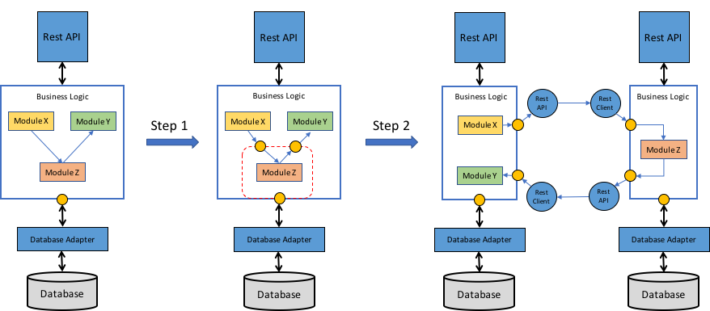
Illustration of Monolithic Module Refactoring
Notes:
The first step of extracting a module is to define a coarse‑grained interface between the module and the monolith. It is mostly likely a bidirectional API, since the monolith will need data owned by the service and vice versa. It is often challenging to implement such an API because of the tangled dependencies and fine‑grained interaction patterns between the module and the rest of the application. Business logic is often especially challenging to refactor because of numerous associations between domain model classes. The development team will often need to make significant code changes to break these dependencies. Figure 5‑6 shows the depiction of the refactoring process.
Once the development team implement the coarse‑grained interface, the team then turns the module into a free‑standing service. To do that, the team must write code to enable the monolith and the service to communicate through an API mechanism. Figure 5‑6 shows the architecture before, during, and after the refactoring.
In Figure 5‑6, Module Z is the candidate module to extract. Its components are used by Module X and it uses Module Y. The first refactoring step is to define a pair of coarse-grained APIs. The first interface is an inbound interface that is used by Module X to invoke Module Z. The second is an outbound interface used by Module Z to invoke Module Y.
The second refactoring step is to turn the module into a standalone service. The inbound and outbound interfaces are implemented by code that uses an API mechanism. The development team now need to build the service by combining Module Z with a microservice framework that handles cross‑cutting concerns such as service discovery.
Once a module has been extracted, the development team has yet another service that can be developed, deployed, and scaled independently of the monolith and any other services. The team can even rewrite the service from scratch; in this case, the API code that integrates the service with the monolith becomes an anti‑corruption layer that translates between the two domain models. Each time the team extract a service, it takes another step in the direction of microservices. Over time, the monolith will shrink and you will have an increasing number of microservices.

Slide 35
Thank You!

